Slide 1

FAST NUCES
ECC LAB
PRESENTATION
Rameen Rafiq (22k-5167)
Laiba Fatima (22k-5195)
Faiza Khan (22k-5160)
Alizah Basit (22k-5155)
Faiq Ahmed Khan (22k-4810)
Hamza Ahmed (22k-5172)

Slide 2
INDEX
01
02
02-A
GRAPHS
LINE GRAPH
INTRODUCTION
02-B
03
04
COMPARISON
CONCLUSION
BAR GRAPH

Slide 3
03
THE
INTRODUCTION

Slide 4
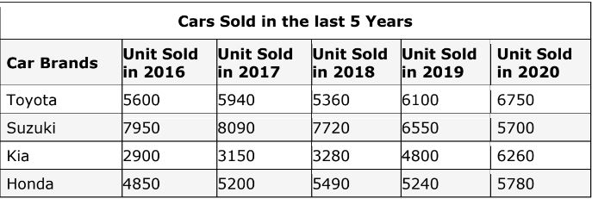
01_INTRODUCTION
TITLE OF GRAPH
The title of both graphs is the car units sold in the last 5 years, from 2016 to 2020, between 4 major car brands: Toyota, Suzuki, Kia, and Honda.

Slide 5

02
GRAPHS
LINE GRAPHS
BAR GRAPHS

Slide 6
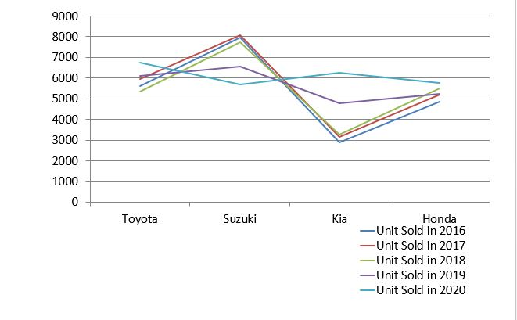
THE LINE GRAPH
02-A
CARS SOLD IN LAST 5 YEARS

Slide 7
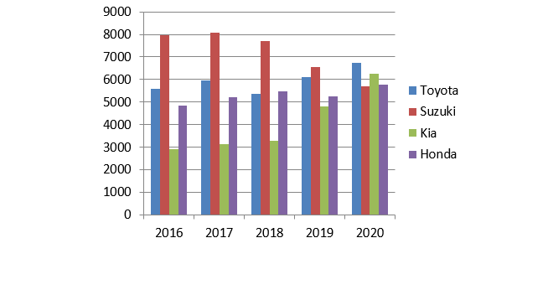
THE BAR GRAPH
02-B
CARS SOLD IN LAST 5 YEARS

Slide 8
EXPLANATION:
So, what is the range of values on the vertical scale?
In both the graphs, the vertical scale represents the car units sold. It starts from 0, and goes up to 9000.
.

Slide 9
EXPLANATION:
Line Graph:
There are 4 categories in the line graph which are the 4 car brands.
Bar Graph:
There are 5 categories in the bar graph, which are the years over which the data has been represented.
.
What are the categories
in the graph?

Slide 10

03
THE
COMPARISON

Slide 11
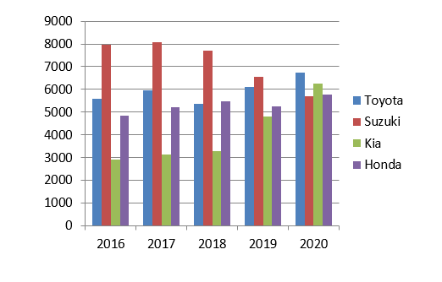
03- COMPARISON
Which car brand has sold more units in total?
In the 5 years combined, the most units are sold by Suzuki which go up to approx. 30k units.

Slide 12
03- COMPARISON
Which car brand has sold the least number of units in total?
In the 5 years combined, the least units are sold by Kia which go down to approx. 20k units.

Slide 13
03- COMPARISON
Most units in total ?
2016 21300 units
2017 22380 units
2018 21850 units
2019 22690 units
2020 24490 units (most)

Slide 14
03- COMPARISON
Two car brands with equal number of units sold in 2018?
Toyota and Honda – both around 5400
How many units have been sold by Toyota over 5 years?
29750 units

Slide 15

04
THE
CONCLUSION

